Slide 1
API
Prepared By :
Eng.Jospheen Boles

Slide 2
Outline
What is API ?
JSON Structure
How to Build API Using PHP

Slide 3
What is API ?

Slide 4
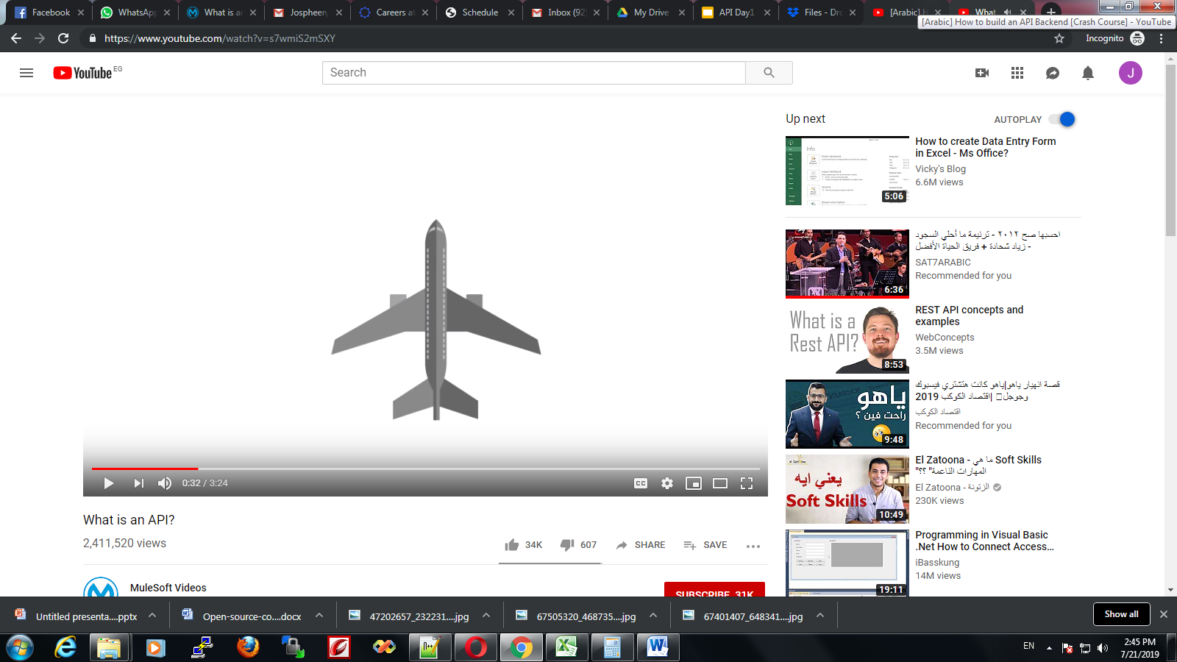
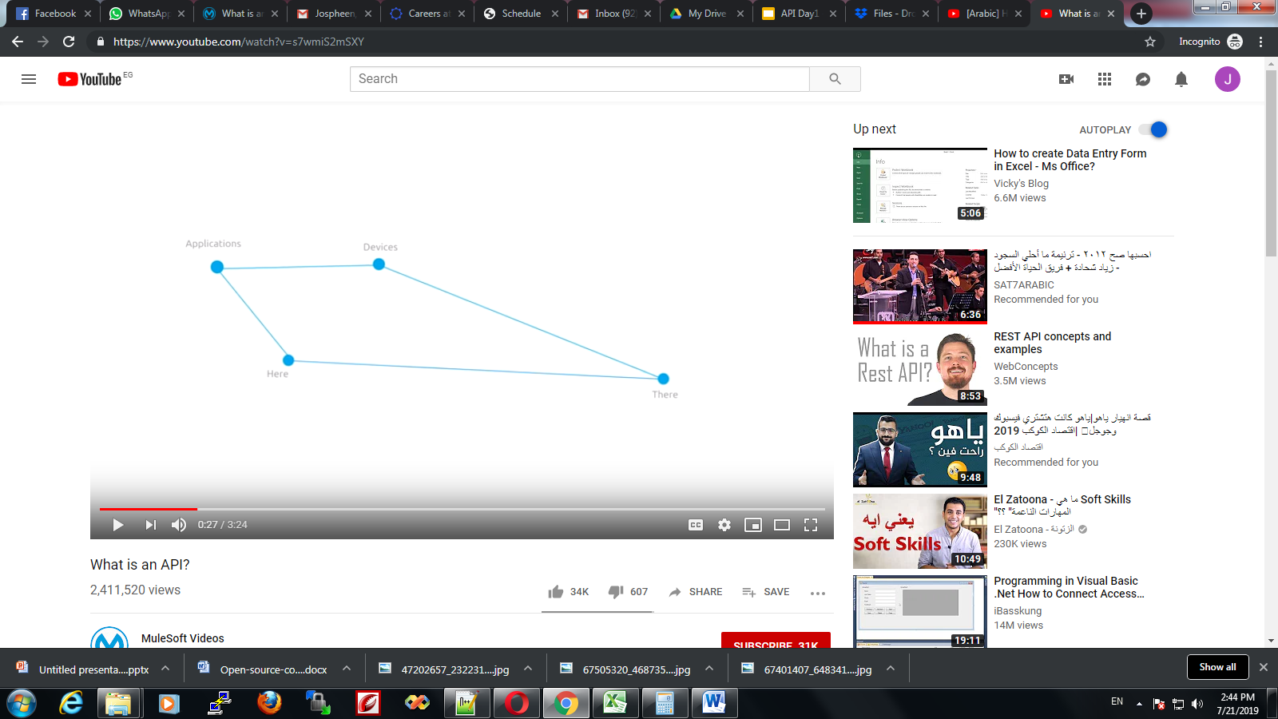

Slide 5
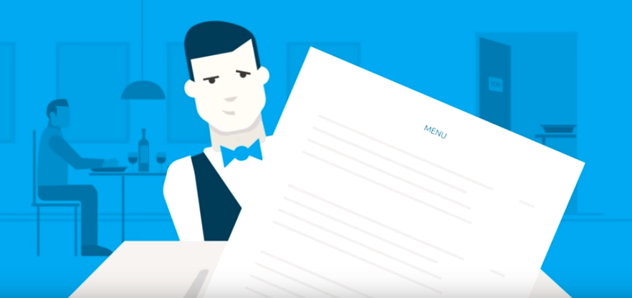

Slide 6
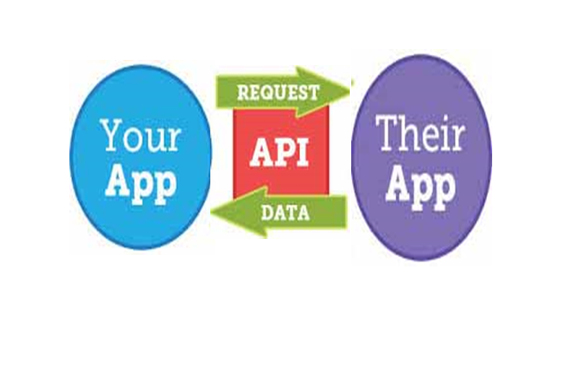

Slide 7
REST API
Enable your application to cooperate with one or several different applications using REST concepts.
Lightest way to create, read, update or delete information between different applications over the internet or HTTP protocol.
https://graph.facebook.com/facebook/picture?redirect=false
Notes:
Representation state trnasfer

Slide 8
Http Request
Header.
Method.
Faults types.
Error | Code
Identity fault | 500,400
Service unavailable | 503,404
Bad Request | 400
Unauthorized | 401

Slide 9
JSON Structure

Slide 10
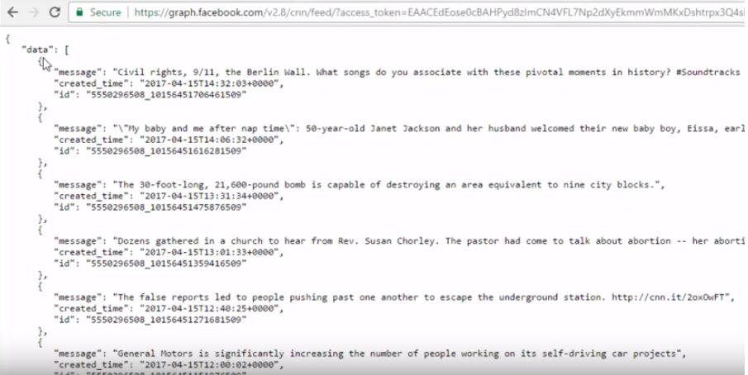
Example
https://www.facebook.com/cnn/

Slide 11
How to Build API Using PHP

Slide 12
FILE STRUCTURE
├─ api/
├─── config/
├─── objects/
├─── product/
├─── shared/

Slide 13
FILE STRUCTURE
├─── config/
├────── core.php - file used for core configuration
├────── database.php - file used for connecting to the database.
├─── objects/
├────── product.php - contains properties and methods for "product" database queries.

Slide 14
├─── product/
├────── create.php - file that will accept posted product data to be saved to database.
├────── delete.php - file that will accept a product ID to delete a database record.
├────── read.php - file that will output JSON data based from "products" database records.
├────── read_paging.php - file that will output "products" JSON data with pagination.
├────── read_one.php - file that will accept product ID to read a record from the database.
├────── update.php - file that will accept a product ID to update a database record.
├────── search.php - file that will accept keywords parameter to search "products" database.

Slide 15
├─── shared/
├────── utilities.php - file that will return pagination array.

Slide 16
SETUP THE DATABASE
CREATE TABLE IF NOT EXISTS `categories` (
`id` int(11) NOT NULL AUTO_INCREMENT,
`name` varchar(256) NOT NULL,
`description` text NOT NULL,
`created` datetime NOT NULL,
`modified` timestamp NOT NULL DEFAULT CURRENT_TIMESTAMP,
PRIMARY KEY (`id`)
) ENGINE=InnoDB DEFAULT CHARSET=utf8 AUTO_INCREMENT=19 ;
Notes:
INSERT INTO `categories` (`id`, `name`, `description`, `created`, `modified`) VALUES
(1, 'Fashion', 'Category for anything related to fashion.', '2014-06-01 00:35:07', '2014-05-30 17:34:33'),
(2, 'Electronics', 'Gadgets, drones and more.', '2014-06-01 00:35:07', '2014-05-30 17:34:33'),
(3, 'Motors', 'Motor sports and more', '2014-06-01 00:35:07', '2014-05-30 17:34:54'),
(5, 'Movies', 'Movie products.', '0000-00-00 00:00:00', '2016-01-08 13:27:26'),
(6, 'Books', 'Kindle books, audio books and more.', '0000-00-00 00:00:00', '2016-01-08 13:27:47'),
(13, 'Sports', 'Drop into new winter gear.', '2016-01-09 02:24:24', '2016-01-09 01:24:24');

Slide 17
SETUP THE DATABASE
CREATE TABLE IF NOT EXISTS `products` (
`id` int(11) NOT NULL AUTO_INCREMENT, `name` varchar(32) NOT NULL, `description` text NOT NULL, `price` decimal(10,0) NOT NULL, `category_id` int(11) NOT NULL,
`created` datetime NOT NULL,
`modified` timestamp NOT NULL DEFAULT CURRENT_TIMESTAMP,
PRIMARY KEY (`id`)
) ENGINE=InnoDB DEFAULT CHARSET=latin1 AUTO_INCREMENT=65 ;
Notes:
INSERT INTO `products` (`id`, `name`, `description`, `price`, `category_id`, `created`, `modified`) VALUES
(1, 'LG P880 4X HD', 'My first awesome phone!', '336', 3, '2014-06-01 01:12:26', '2014-05-31 17:12:26'),
(2, 'Google Nexus 4', 'The most awesome phone of 2013!', '299', 2, '2014-06-01 01:12:26', '2014-05-31 17:12:26'),
(3, 'Samsung Galaxy S4', 'How about no?', '600', 3, '2014-06-01 01:12:26', '2014-05-31 17:12:26'),
(6, 'Bench Shirt', 'The best shirt!', '29', 1, '2014-06-01 01:12:26', '2014-05-31 02:12:21'),
(7, 'Lenovo Laptop', 'My business partner.', '399', 2, '2014-06-01 01:13:45', '2014-05-31 02:13:39'),
(8, 'Samsung Galaxy Tab 10.1', 'Good tablet.', '259', 2, '2014-06-01 01:14:13', '2014-05-31 02:14:08'),
(9, 'Spalding Watch', 'My sports watch.', '199', 1, '2014-06-01 01:18:36', '2014-05-31 02:18:31'),
(10, 'Sony Smart Watch', 'The coolest smart watch!', '300', 2, '2014-06-06 17:10:01', '2014-06-05 18:09:51'),
(11, 'Huawei Y300', 'For testing purposes.', '100', 2, '2014-06-06 17:11:04', '2014-06-05 18:10:54'),
(12, 'Abercrombie Lake Arnold Shirt', 'Perfect as gift!', '60', 1, '2014-06-06 17:12:21', '2014-06-05 18:12:11'),
(13, 'Abercrombie Allen Brook Shirt', 'Cool red shirt!', '70', 1, '2014-06-06 17:12:59', '2014-06-05 18:12:49'),
(26, 'Another product', 'Awesome product!', '555', 2, '2014-11-22 19:07:34', '2014-11-21 20:07:34'),
(28, 'Wallet', 'You can absolutely use this one!', '799', 6, '2014-12-04 21:12:03', '2014-12-03 22:12:03'),
(31, 'Amanda Waller Shirt', 'New awesome shirt!', '333', 1, '2014-12-13 00:52:54', '2014-12-12 01:52:54'),
(42, 'Nike Shoes for Men', 'Nike Shoes', '12999', 3, '2015-12-12 06:47:08', '2015-12-12 05:47:08'),
(48, 'Bristol Shoes', 'Awesome shoes.', '999', 5, '2016-01-08 06:36:37', '2016-01-08 05:36:37'),
(60, 'Rolex Watch', 'Luxury watch.', '25000', 1, '2016-01-11 15:46:02', '2016-01-11 14:46:02');

Slide 18
<?php
class product
{ // database connection and table name
private $conn;
private $table_name = "products";
// object properties
public $id;
public $name;
public $description;
public $price;

Slide 19
public $category_id;
public $category_name;
public $created;
// constructor with $db as database connection
public function __construct($db){
$this->conn = $db;
}

Slide 20
// read products
function read(){
// select all query
$query = "SELECT c.name as category_name, p.id, p.name, p.description, p.price, p.category_id, p.created
FROM " . $this->table_name . " p LEFT JOIN categories c
ON p.category_id = c.id ORDER BY p.created DESC";
// prepare query statement
$stmt = $this->conn->prepare($query);

Slide 21
// execute query
$stmt->execute();
return $stmt;
}
}
?>

Slide 22
<?php
// required headers
header("Access-Control-Allow-Origin: *");
header("Content-Type: application/json; charset=UTF-8");
// database connection will be here
// include database and object files
include_once '../config/database.php';
include_once '../objects/product.php';

Slide 23
// instantiate database and product object
$database = new Database();
$db = $database->getConnection();
// initialize object
$product = new Product($db);
// read products will be here
// query products
$stmt = $product->read();
$num = $stmt->rowCount();

Slide 24
// check if more than 0 record found
if($num>0){
// products array
$products_arr=array();
$products_arr["records"]=array();
// retrieve our table contents
// fetch() is faster than fetchAll()
// http://stackoverflow.com/questions/2770630/pdofetchall-vs-pdofetch-in-a-loop
while ($row = $stmt->fetch(PDO::FETCH_ASSOC)){

Slide 25
// extract row // this will make $row['name'] to // just $name only
extract($row);
$product_item=array(
"id" => $id,
"name" => $name,
"description" => html_entity_decode($description),
"price" => $price,
"category_id" => $category_id,
"category_name" => $category_name
);
array_push($products_arr["records"], $product_item);
}
// set response code - 200 OK
http_response_code(200);
// show products data in json format
echo json_encode($products_arr);
}
else{
// set response code - 404 Not found
http_response_code(404);
// tell the user no products found
echo json_encode(
array("message" => "No products found.")
);
}
?>

Slide 26
array_push($products_arr["records"], $product_item);
}
// set response code - 200 OK
http_response_code(200);
// show products data in json format
echo json_encode($products_arr);
} else{
// set response code - 404 Not found
http_response_code(404);
// tell the user no products found
echo json_encode( array("message" => "No products found.") ); } ?>

